Slide 1
机器学习与量化交易实战
第五讲

Slide 2
第一次作业
有效递交者：
ruoang@qq.com
315135833@qq.com
Zhangyiizhi
273511010
32969472国光
1719466902宝宝
vicky_violin
郭高安
任远航
Victorxu
冯斐
Jared Qu
Ross

Slide 3
作业格式的提交建议
检查入口为ipython notebook的demo
如果有自己的较复杂函数，可以单独将.py文件同notebook一同提交，demo中import相关文件即可

Slide 4
Where are we now
Get the data
Store the data
Transform data into training set
Building predictive models
Building event driving back-test pipelines

Slide 5
WARNING
Building Models vs Building （event driving）trading strategies
以上二者并不一样，这周关注第一件事（第一件事是第二件事的基础）

Slide 6
建立训练集

Slide 7
How to choose Features(predictors)
选择特征是quant对问题的一种理解
不同的人有不同的信念
不同的信念会造成不同的features选择
Pipeline相同
这次课：
选择features的主要流程和基本方法
下次课（save your ass)：如何从选出来的一坨也许不是很好的特征中进行自动筛选和变换

Slide 8
基本方法和原则
因子的选择取决于你对问题的理解
举例：你认为沪深三百股指和什么事情有关？

Slide 9
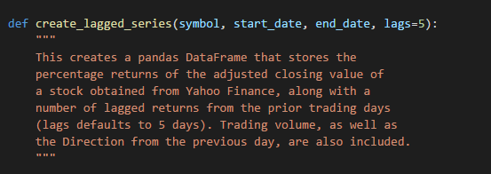
常见的features
Time lags

Slide 10
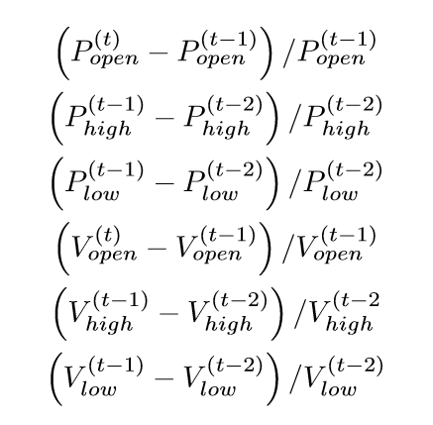
常见的features

Slide 11
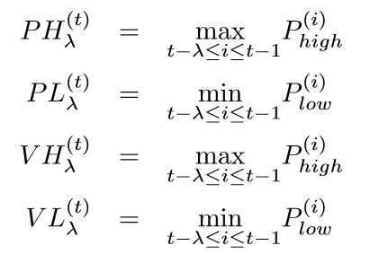
常见的features

Slide 12
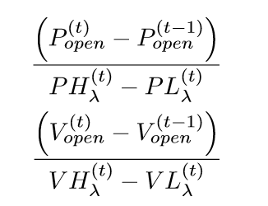
常见的features

Slide 13
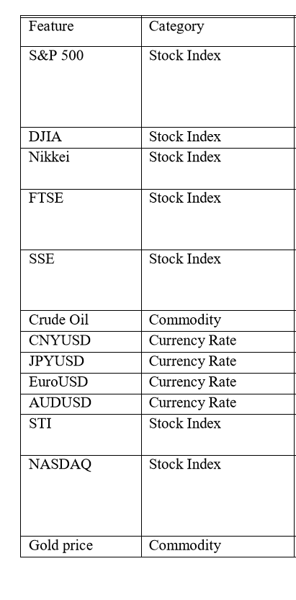
常见的features

Slide 14
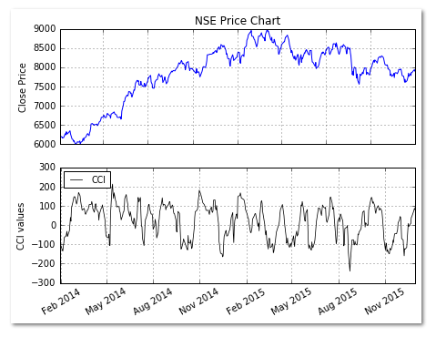
常见的features
CCI
CCI = (Typical price – MA of Typical price) / (0.015 * Standard deviation of Typical price)

Slide 15
常见的features
CCI can be used to determine overbought and oversold levels. Readings above +100 can imply an overbought condition, while readings below −100 can imply an oversold condition. However, one should be a careful because a security can continue moving higher after the CCI indicator becomes overbought. Likewise, securities can continue moving lower after the indicator becomes oversold.
Whenever the security is in overbought/oversold levels as indicated by the CCI, there is a good chance that the price will see corrections. Hence a trader can use such overbought/oversold levels to enter in short/long positions.
Traders can also look for divergence signals to take suitable positions using CCI. A bullish divergence occurs when the underlying security makes a lower low and the CCI forms a higher low, which shows less downside momentum. Similarly, a bearish divergence is formed when the security records a higher high and the CCI forms a lower high, which shows less upside momentum.

Slide 16
常见的features
Ease of Movement (EVM)
Distance moved = ((Current High + Current Low)/2 - (Prior High + Prior Low)/2)
Ease of Movement (EMV) is a volume-based oscillator which was developed by Richard Arms. EVM indicates the ease with which the prices rise or fall taking into account the volume of the security. For example, a price rise on a low volume means prices advanced with relative ease, and there was little selling pressure. Positive EVM values imply that the market is moving higher with ease, while negative values indicate an easy decline.

Slide 17
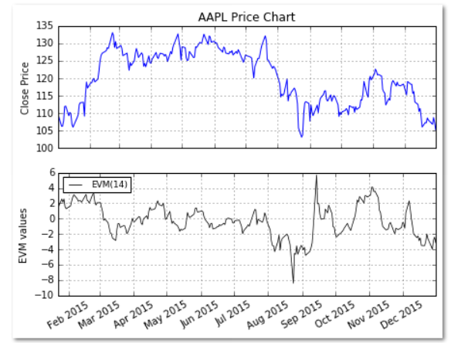
常见的features
Ease of Movement (EVM)

Slide 18
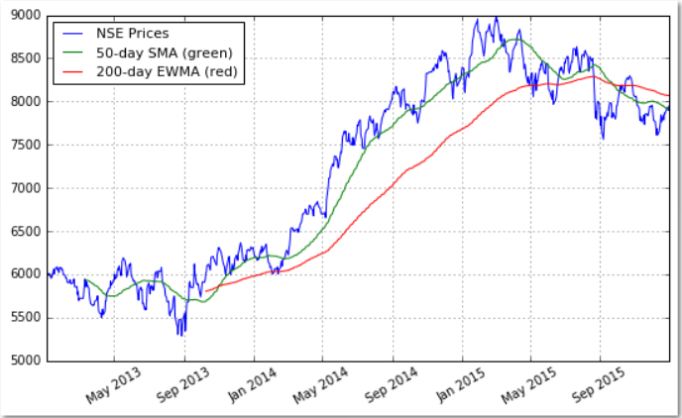
常见的features
ma

Slide 19
常见的features
Rate of Change (ROC)
The Rate of Change (ROC) is a technical indicator that measures the percentage change between the most recent price and the price “n” day’s ago. The indicator fluctuates around the zero line.
If the ROC is rising, it gives a bullish signal, while a falling ROC gives a bearish signal. One can compute ROC based on different periods in order to gauge the short-term momentum or the long-term momentum.

Slide 20
常见的features
Bollinger Bands
These bands comprise of an upper bollinger band and a lower bollinger band, and are placed two standard deviations above and below a moving average.
Bollinger bands expand and contract based on the volatility. During a period of rising volatility, the bands widen, and they contract as the volatility decreases. Prices are considered to be relatively high when they move above the upper band and relatively low when they go below the lower band.

Slide 21
常见的features
Force Index
The force index was created by Alexander Elder. The force index takes into account the direction of the stock price, the extent of the stock price movement, and the volume. Using these three elements it forms an oscillator that measures the buying and the selling pressure.
Each of these three factors plays an important role in determination of the force index. For example, a big advance in prices, which is given by the extent of the price movement, shows a strong buying pressure. A big decline on heavy volume indicates a strong selling pressure.

Slide 22
And More………
See
http://stockcharts.com/school/doku.php?id=chart_school:technical_indicators

Slide 23
作业0
建立你自己的feature extracting 库，并命名为FeatureUtils.py
When in use, just
import FeatureUtils

Slide 24
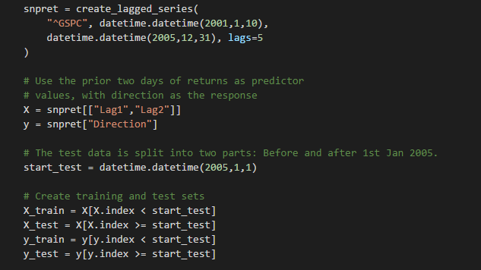
建立训练集

Slide 25
modeling
Random Forests

Slide 42
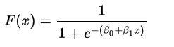
modeling
Logistic Regression

Slide 43
modeling
LASSO

Slide 44
modeling
SVMs

Slide 45
modeling
ANN
Model architecture and activation functions

Slide 46
modeling
ANN
Loss function
Cross entropy for classification
MSE for regression

Slide 47
modeling
ANN
Hyper-parameters

Slide 48
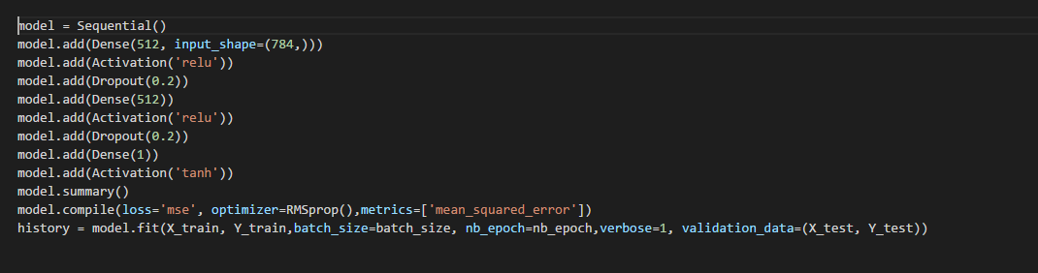
modeling
ANNs

Slide 49
Cross validation

Slide 50
Homework 1
1）沪深三百股指的预测分类/回归模型
要求：至少10个features，并plot出feature importances
（http://scikit-learn.org/stable/auto_examples/ensemble/plot_forest_importances.html#sphx-glr-auto-examples-ensemble-plot-forest-importances-py）
模型：需要进行cross validation
汇报结果：plot the results with confusion matrix(for classification problems)

Slide 51
回归任务的要求
Plot出每一个time step的真实值和预测值，真实值为蓝色，预测值为红色

Slide 52
Homework 2
1）股票价格的预测分类/回归模型
1. price between 10-50
2. 沪深三百内的
3. average daily volume (ADV) in the middle 33 percentile

Slide 53
Homework 2
根据给定数据，建立回归模型，并汇报r^2值
链接: http://pan.baidu.com/s/1nvDBqlj 密码: 5tc3

